Slide 1


BUSINESS DATA MANAGEMENT CAPSTONE PROJECT
Project on:
Data-Driven Sales, Inventory, and Profit Optimization in Agricultural Retail Business
Presented by:
Chandan Kumar
23f1003153

Slide 2
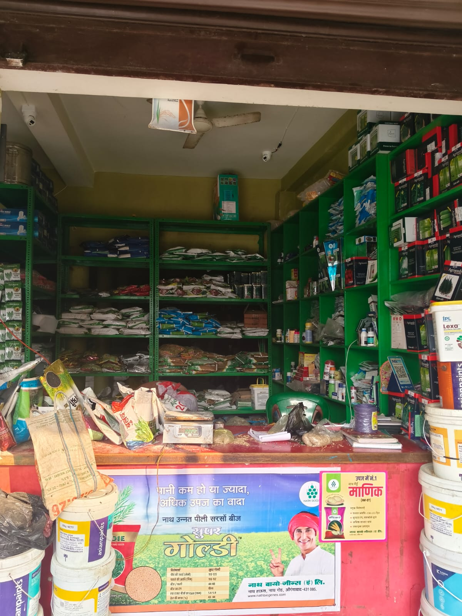
Organization Background
Krishi Khad Bhandar
Agricultural retail shop located in Belhariya, Gaya, Bihar
Established 20 years ago
Business Type : B2B and B2C both
Supplies:
  Fertilizers
  Seeds
  Pesticides
Serves:
  Farmers
  Local retailers
Dataset used:
Sales records from March 2023 – December 2025
Key business challenges:
  Difficulty understanding seasonal sales trends
  Inventory management issues
  Uneven regional revenue distribution
  Storage space constraints

Slide 3
Data Collection
Dataset used in the project includes sales records from 2023–2025.
Variables collected:
  Transaction Date
  Product Name
  Product Category
  Unit Price
  Quantity Sold
  Total Sales Value
  Region
Data Source:
Shop transaction records and sales registers.
Data Cleaning & Preparation
Before analysis the dataset was processed using Microsoft Excel.
Data preprocessing steps:
  Removing duplicate entries
  Handling missing values
  Standardizing product names
  Organizing dataset into structured format
Purpose:
Ensure accurate and reliable analysis.
j
Tools used:
  Excel filtering
  Sorting
  Pivot tables
  Conditional formatting

Slide 4
Problem 1: Difficulty in Understanding Seasonal Sales Trends
Background:
Although the store has accumulated several years of sales data, it is not utilized effectively for decision-making. Specifically, the store cannot identify which season generates the highest revenue.
Objective:
Identify sales trends and seasonal demand patterns using trend analysis.
Key Insights:
  Sales show a strong seasonal pattern.
  Peak demand in July (Kharif season) and Nov–Dec (Rabi season).
  Demand for seeds and fertilizers follows crop sowing cycles.

Slide 5
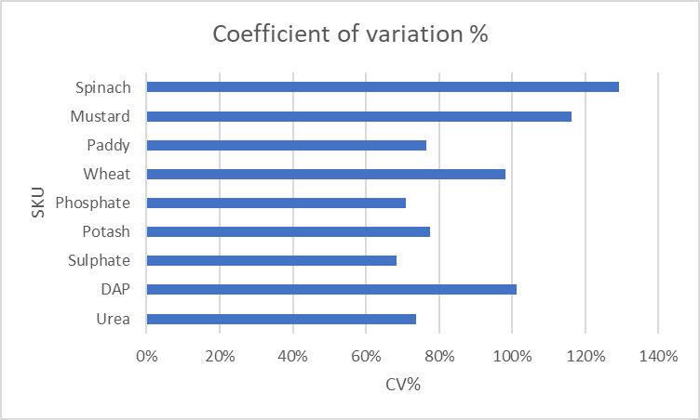
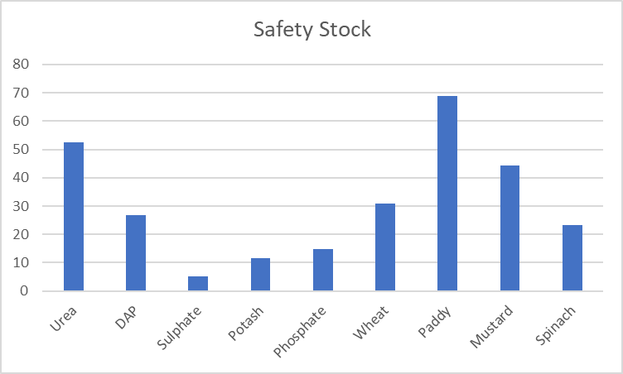
  Problem 2 : Inventory management issues
  Background:
  Agricultural demand is highly seasonal, causing large fluctuations in product sales and making inventory planning difficult.
  Objective:
  Evaluate demand variability across products using the Coefficient of Variation (CV) and determine appropriate Safety Stock levels.
  Key Insights:
    Several products show high demand variability, increasing inventory risk.
    Spinach, Mustard, and DAP have very high CV values, indicating unpredictable demand.
    High-demand products like Paddy and Urea require larger safety stock to prevent stockouts during peak seasons.
    Stable products such as Sulphate and Phosphate require lower buffer inventory.

Slide 6
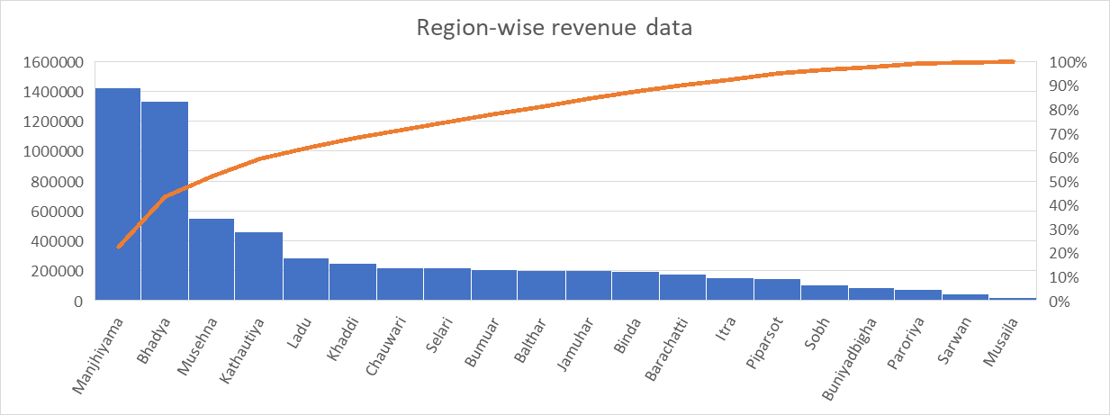
Problem 3: Uneven Regional Revenue Distribution
Background:
Lack of regional sales analysis makes it difficult to plan inventory, manage storage space, and understand differences in demand across villages.
Objective:
Analyze regional revenue contribution to identify high-performing and low-performing markets.
Key Insights:
  Revenue is highly concentrated in a few regions.
  Manjhiyama and Bhadya contribute the highest share of total revenue.
  Several regions such as Sarwan, Musaila, Paroriya, and Buniyadbigha generate relatively low sales.
  Overdependence on a few regions increases business risk if demand declines in those areas.

Slide 7
Problem 4: Limited Storage Space
Background:
Limited storage space in the shop leads to inefficient stock management, especially during peak agricultural seasons when multiple fertilizers arrive simultaneously.
Objective:
Understand relationships between products using correlation analysis to optimize storage and stocking strategies.
Key Insight : Complementary Product Demand
  Strong positive correlations exist between Urea, Potash, Sulphate, and DAP.
  Farmers often purchase these fertilizers together during the same crop cycle.
  This indicates complementary demand among these products.

Slide 8
Business Recommendations
Difficulty in Understanding Seasonal Sales Trends
  Seasonal Inventory Planning
  Increase stock before June–July (Kharif season).
  Increase stock before October–November (Rabi season).
  Reduce inventory during March–May off-season.
  Inventory management issues
  Implement seasonal inventory planning by increasing stock before major sowing seasons.
  Maintain higher safety stock for high-CV products to avoid stockouts.
  Use moderate inventory levels for medium variability products and regular replenishment for stable products.
  Monitor demand patterns regularly to adjust stock levels and reduce excess inventory.
Uneven Regional Revenue Distribution
  Maintain higher inventory availability in high-performing regions to avoid stock shortages.
  Implement targeted promotions and awareness campaigns in medium-performing regions.
  Explore distribution expansion and improved accessibility in low-performing regions.
  Diversify sales across more villages to reduce revenue concentration risk.
Limited Storage Space
Bundle-Based Product Strategy:
Stock Urea, Potash, Sulphate, and DAP together to improve storage efficiency.
Offer fertilizer bundle deals during peak farming seasons.
Arrange complementary products in the same storage or display area to simplify inventory management and improve sales.

Slide 9





Improvement & Future Growth
Inventory Automation
Adopt basic inventory management software to track stock levels and reduce shortages.
Demand Forecasting
Use time-series forecasting models to predict seasonal demand more accurately.
Regional Market Expansion
Expand sales in low-performing regions through awareness campaigns and better distribution.
Digital Sales & Delivery
Introduce phone/WhatsApp ordering and home delivery for farmers or local retailers in nearby villages.
Data-Driven Decision Making
Continuously analyze sales data to improve inventory planning, marketing, and storage management.

Slide 10
CONCLUSION
Project Impact
The recommendations provided are simple, practical, and data-driven steps, not complex theories
By implementing these strategies agricultural store can move from state of reaction to one of control.
Thank You

